Slide 2
XML Namespaces
In this first lesson XML Namespaces, you will learn to:
  Identify the need for a namespace.
  Define and describe namespaces in XML.
2

Slide 3
Duplicate Element Names
XML allows developers to create their own elements and attributes for their own projects.
These elements or attributes can be shared by the developers working on similar projects all over the world.
Example:
  An author of an XML document includes element called <title> in a <CD> element.
  Another author creates an element <title> in a <Book> element.
  Problem will arise if the <title> element created by two different authors, is merged into a single XML document.
  XML developer has to ensure the uniqueness of the element names and attributes in a document.

Slide 4
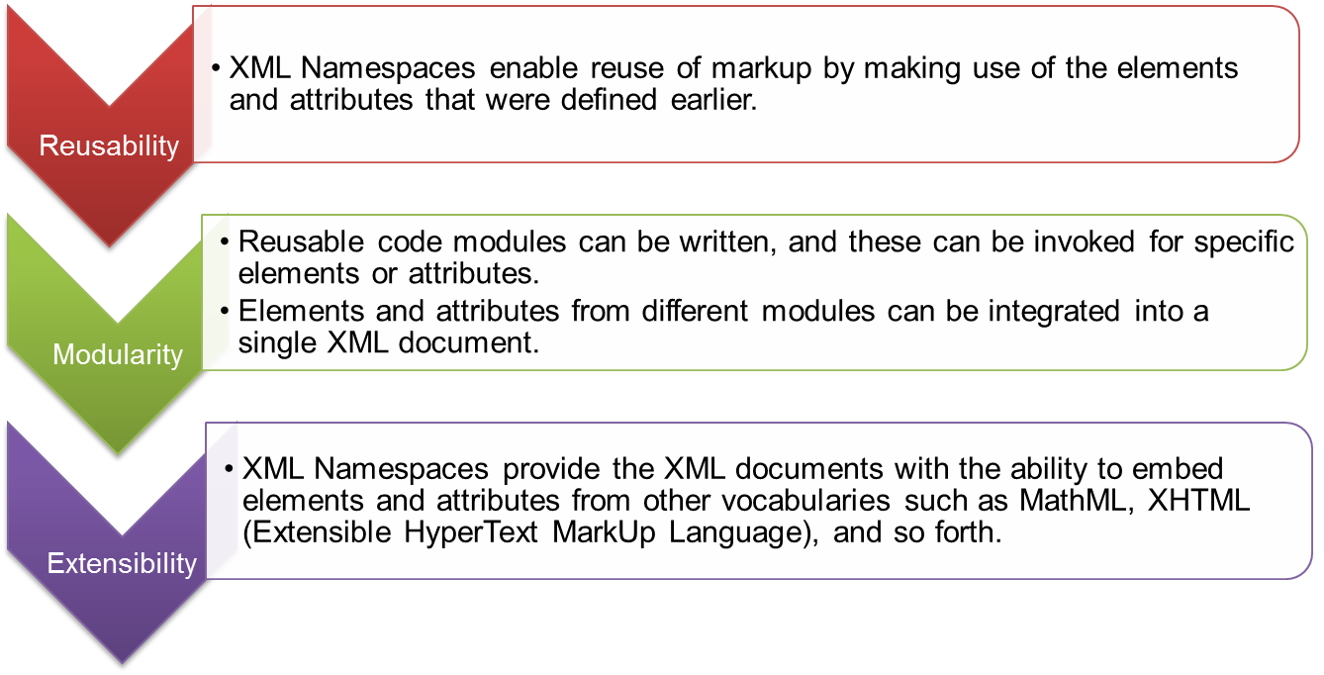
Namespaces
In XML, elements are distinguished by using namespaces.
A namespace is a collection of names that can be used as element names or attribute names in XML document.
XML namespaces provide the following advantages:

Slide 5
Working with Namespaces Syntax
In this last lesson, Working with Namespaces syntax, you will learn to:
  Explain the syntax for XML namespaces.
  Discuss attributes and namespaces.
  Discuss how to use default namespaces.

Slide 6
Prefixing Element Names
Use of namespaces to solve conflict within element names:
  Namespaces are a mechanism by which element and attribute names can be assigned to groups.
  XML Namespace prefixes are directly attached to names as well as names of its attributes and descendants.
  The codes demonstrates using the prefixes in the element names.
  Use of prefixes provide a means for the document authors to prevent name collisions.
Snippet
<CD:Title> Feel </CD:Title>
Snippet
<Book:Title> Returning to Earth </Book:Title>

Slide 7
Problems Posed By Prefixes
The reason for prefixing an element in a XML document is to prevent it from being duplicated.
If the prefixes are not unique, the original problem of duplication would still exist.
To solve this problem:
  Each namespace prefix is added to a Uniform Resource Identifier or URI that uniquely identifies the namespace.
The code demonstrate a company's URI which is located at http://www.spectrafocus.com.
To guarantee name uniqueness in any XML documents that the company creates, the documents are associated with their namespace.
Snippet
<S:Student xmlns:S= "http://www.spectrafocus.com /student/">
  <S:First>John</S:First>
  <S:Last>Dewey</S:Last>
  <S:Title>Student</S:Title>
</S:Student>

Slide 8
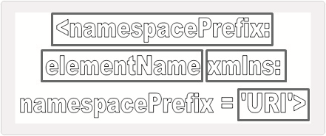
Namespace Syntax 1-2
The XML namespace attribute is placed in the start tag of an element:
  namespacePrefix
    Each namespace has a prefix that is used as a reference to the namespace.
    Prefixes must not begin with xmlns or xml.
    A namespace prefix can be any legal XML name that does not contain a colon.
    A legal XML name must begin with a letter or an underscore.
  elementName
    It specifies the name of the element.
  xmlns
    The xmlns attribute is what notifies an XML processor that a namespace is being declared. xmlns stands for XML Namespace.
  URI
    A Uniform Resource Identifier (URI) is a string of characters which identifies an Internet Resource and are case-sensitive.

Slide 9
Namespace Syntax 2-2
The code demonstrates the properties of namespace.
The elements that are prefixed with Auc are associated with a namespace with name http://www.auction.com/books.
Those prefixed with B are associated with a namespace whose name is http://www.books.com/HTML/1998/xml1.
Snippet
<Auc:Books xmlns:Auc="http://www.auction.com/books"
xmlns:B="http://www.books.com/HTML/1998/xml1">
...
<Auc:BookReview>
<B:Table>
...

Slide 10
Placing Attributes in a Namespace 1-2
An attribute name has no prefix, it has no namespace.
An attribute without a prefix is in default namespace.
An attribute name has a prefix, its name is in the namespace indicated by the prefix.
where,
  prefix is used as a reference to the namespace. Prefixes must not begin with xmlns or xml.
  localname is the name of an attribute.
  value mentions a user defined value for an attribute.
Syntax
prefix:localname='value‘
or
prefix:localname="value“

Slide 11
Placing Attributes in a Namespace 2-2
The code demonstrates the type attribute is associated with the book namespace since it is preceded by the prefix Book.
Snippet
<Catalog xmlns:Book = "http://www.aptechworldwide.com">
  <Book:Booklist>
  <Book:Title Book:Type = "Fiction">Evening in Paris</Book:Title>
  <Book:Price>$123</Book:Price>
  </Book:Booklist>
</Catalog>

Slide 12
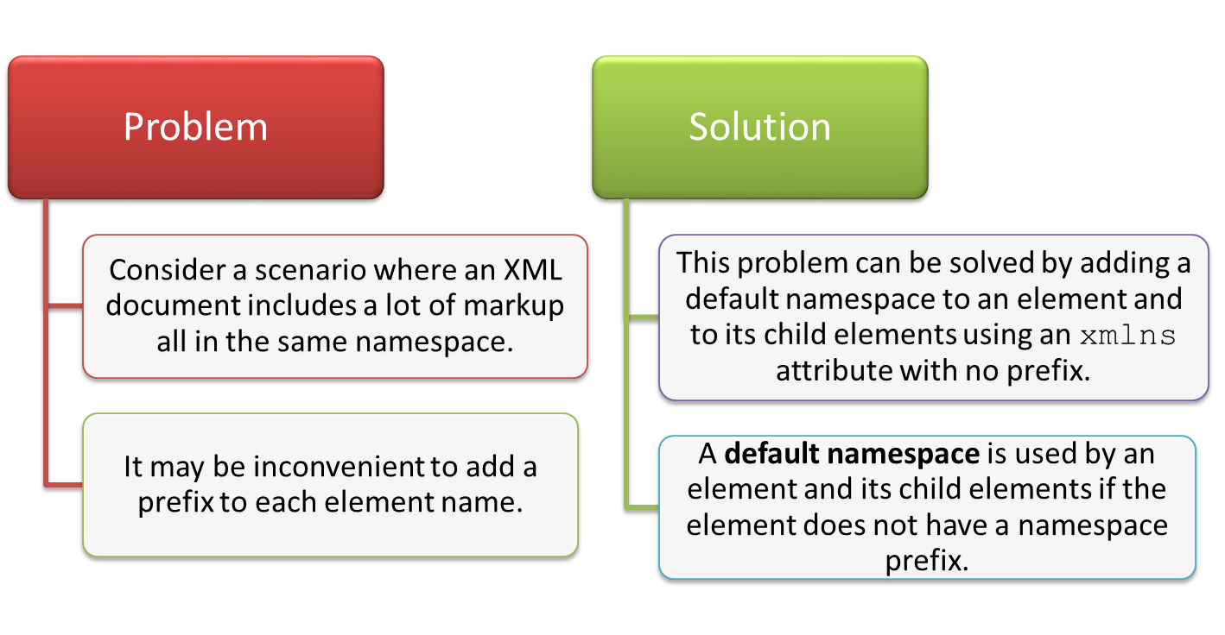
Default Namespace 1-2

Slide 13
Default Namespace 2-2
where,
  elementName specifies the name of the element belonging to the same namespace.
  URL specifies the namespace which is reference for a document or an HTML page on the Web.
The code demonstrates the default namespace.
Syntax
<elementName xmlns='URL'>
Snippet
<Catalog xmlns="http://www.aptechworldwide.com">
<BookList>
  <Title type = "Thriller">African Safari</Title>
  <Price>$12</Price>
  <ISBN>23345</ISBN>
</Booklist>
</Catalog>

Slide 14
Override Default Namespaces
The default namespace applies to the element on which it was defined and all descendants of that element.
If one of the descendants has another default namespace defined on it then:
  This new namespace definition overrides the previous one.
  Becomes the default for that element and all its descendants.
The code demonstrates overriding the default namespace.
In the second book element, the namespace applies only to the price element and overrides the namespace in the catalog element.
Snippet
<Catalog xmlns = "http://www.aptechworldwide.com">
<Book>
<Title type = "Fiction">Evening in Paris</Title>
<Price>$123</Price>
</Book>
<Book>
<Title type = "Non-Fiction">Return to Earth</Title>
<Price xmlns = "http://www.aptech.ac.in">$23</Price>
<Title type = "Non-Fiction">Journey to the center of the Moon</Title>
<Price>$123</Price>
</Book>
</Catalog>

Slide 15
Best Practices for Using XML Namespaces 1-2
Some of the best practices that are used for declaring XML Namespaces are as follows:
  Namespaces should be properly planned.
  Logical and consistent prefix names should be used for convenience while creating an XML document.
  Namespaces should be applied to a personal vocabulary, even when there is just one.
  Namespaces should be used to separate or isolate elements that may otherwise seem similar.
  When designing two vocabularies that have some elements in common, one namespace should be used to hold the common items.
  HTTP URLs should be used for the URIs.
  Namespace URI should change for every substantive change to the vocabulary, including the addition and deletion of new elements.
  If possible, one prefix should be used for one namespace throughout all XML documents in a system.

Slide 16
Best Practices for Using XML Namespaces 2-2
  All namespace declarations should be made in the start tag of the document element.
  Domain names such as namespaces.com, namespaces.net, or namespaces.org should be used in the XML document.

Slide 17
Summary
In this module, Namespaces, you learnt about:
  XML Namespaces
    Namespaces distinguish between elements and attributes with the same name from different XML applications. It is a collection of names that can be used as element names or attribute names in XML document. XML Namespaces provide a globally unique name for an element or attribute to avoid name collisions.
  Working with Namespaces syntax
    Namespaces are declared by an xmlns attribute whose value is the URI of the namespace. If an attribute name has no prefix, it has no namespace. A default namespace is used by an element and its child elements if the element does not have a namespace prefix.

